Slide 1


Firma convenzione Politecnico di Milano e Veneranda Fabbrica del Duomo di Milano
Lagrangian and Eulerian Multi-Scale Control of a Distributed Multibody Robotic System
M.Sc Thesis in Mechanical Engineering
Francesco TASSI
Supervisor: Prof. Francesco BRAGHIN
Mentor: Dr. Marco B. QUADRELLI
Aula Magna – Rettorato
Mercoledì 27 maggio 2015

Slide 2
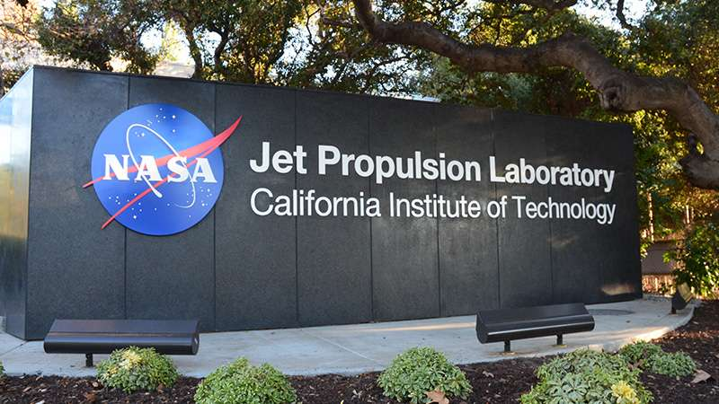
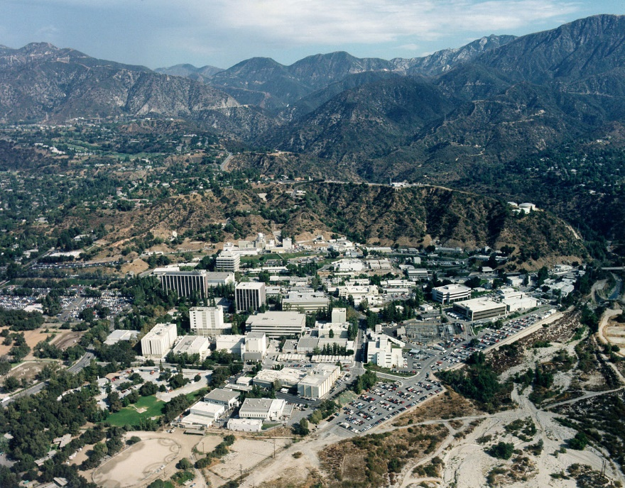
JET PROPULSION LABORATORY
This research was developed at Jet Propulsion Laboratory, California Institute
of Technology, during the six-month internship sponsored by JVSRP (JPL Visiting Student
Research Program) and NASA.
Notes:
GM to everybody, I am, and this is the research I developed at JPL. I want to thank my superv for allowing me to experience this 6m internship in such a fascinating and challenging environment.

Slide 3
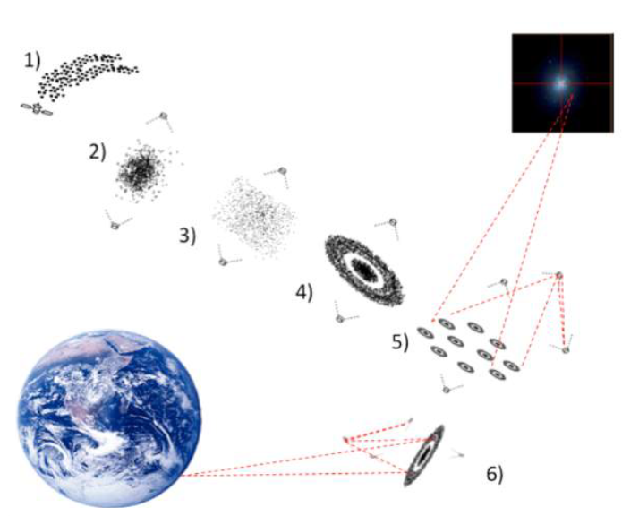
DISTRIBUTED MULTIBODY SYSTEM
It is a multibody system composed of a large number of non-contacting elements.
Its modeling is more challenging compared to conventional spacecrafts, since we are dealing with a probabilistic vehicle.
Its advantages include: lightness and reduced costs, very large and recofigurable structure, ease of packaging and deployment, high fault tolerance with reduced vulnerability to impacts and losses.

Slide 4
HYBRID CONTROL OF A DISTRIBUTED SYSTEM
A distributed system can be seen as a fluid in motion, widening the modeling possibilities beyond a single approach.
A Lagrangian rather than Eulerian framework can be dictated by the utilisation circumnstances or by the specific requirements.
An Hybrid Control formulation could grant higher flexibility, and aim at the concrete realization of a distributed system.
Distributed System
Lagrangian Approach
Eulerian Approach
Deterministic Control
Stochastic Control

Slide 5
Firma convenzione Politecnico di Milano e Veneranda Fabbrica del Duomo di Milano
LAGRANGIAN APPROACH FOR THE CONTROL OF A DISTRIBUTED SYSTEM
Aula Magna – Rettorato
Mercoledì 27 maggio 2015

Slide 6
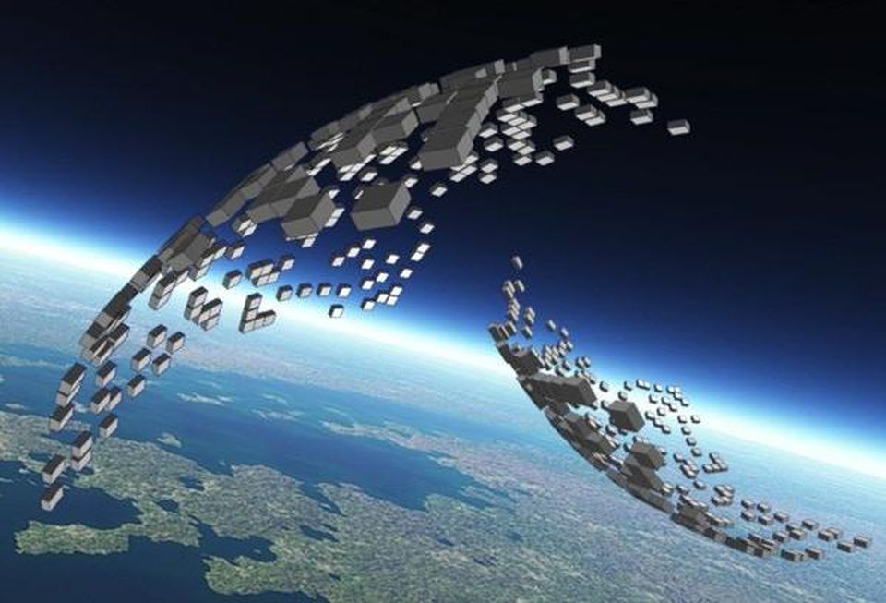
VERY LARGE SCALE ROBOTIC (VLSR) SYSTEM
Very Large Scale Robotic (VLSR) systems are composed of hundreds to possibly tens of thousands of small-scale autonomous robots.
Ground applications for industrial assembling, exploring or patrolling tasks, or in military field applications.
Space applications for creating large-aperture and reconfigurable observatories from confined swarms of robots.

Slide 7
LAGRANGIAN BASED APPROACH FEATURES
pros
cons
Possibility of adopting a deterministic control logic, thus resulting in higher precision and allowing formation flying applications.
Robustness of the control algorithm.
Abundant literature and simplicity in the formulation.
Poor scalability with respect to the increase in the number of elements composing the swarm.

Slide 8
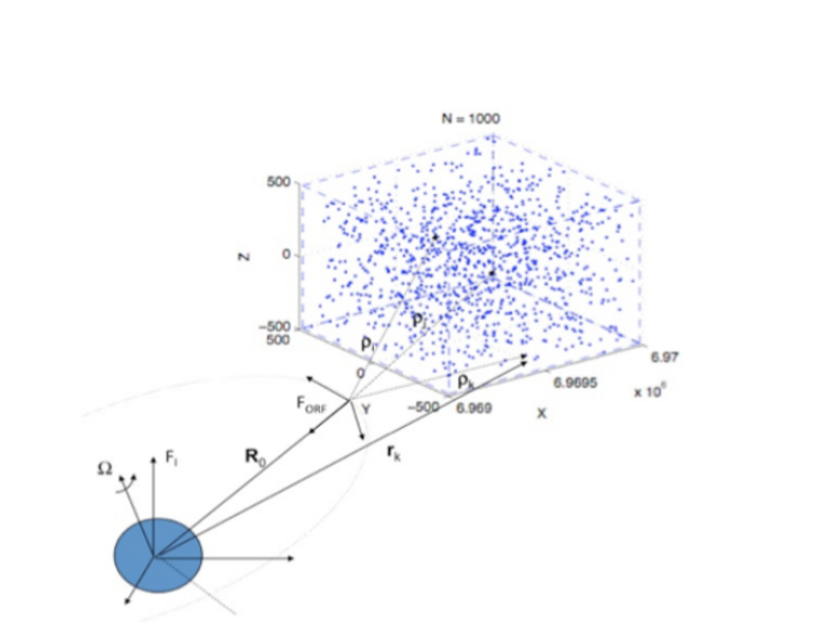
DISTRIBUTED SYSTEM MODELING - ASSUMPTIONS
Main assumptions :
System composed of N rigid bodies, orbiting around an Earth-centered inertial (ECI) reference frame.
The formation dynamics is described (and numerically integrated) with respect to an Orbiting Reference Frame (ORF).
The ORF follows a geostationary orbit.
The rotational quantities are expressed in quaternion form and are referred to the ECI reference frame.

Slide 9
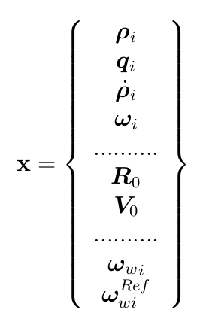
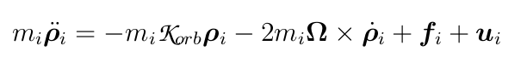
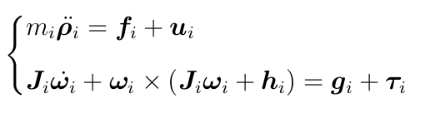
DISTRIBUTED SYSTEM MODELING
Main assumptions :
System composed of N rigid bodies, orbiting around an Earth-centered inertial (ECI) frame.
The formation dynamics is described (and numerically integrated) with respect to an Orbiting Reference Frame (ORF).
The ORF follows a geostationary orbit.
The rotational quantities are expressed in quaternion form and are referred to the ECI reference frame.
Translational and Rotational Dynamics (i-th agent)

Slide 10
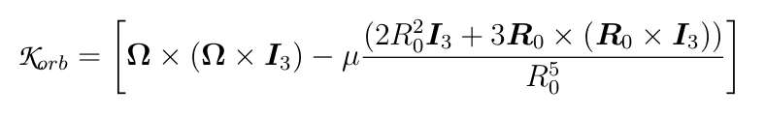
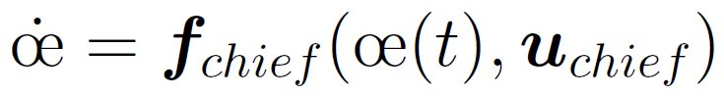
DISTRIBUTED SYSTEM MODELING – DYNAMIC EQUATIONS
Translational and Rotational Dynamics (i-th agent)
where the ”gravitational” stiffness matrix is defined as:
Whereas, the equations of motion describing the dynamics of the ORF are considered as:

Slide 11
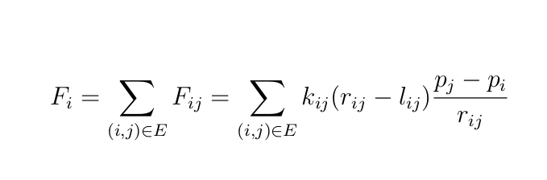
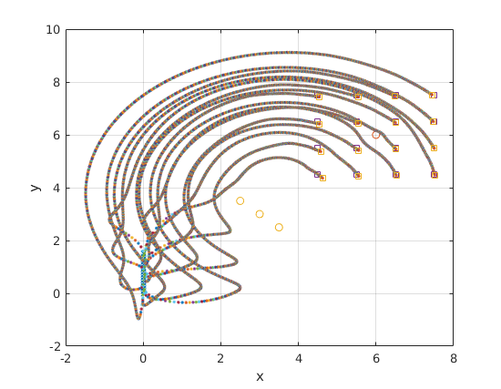
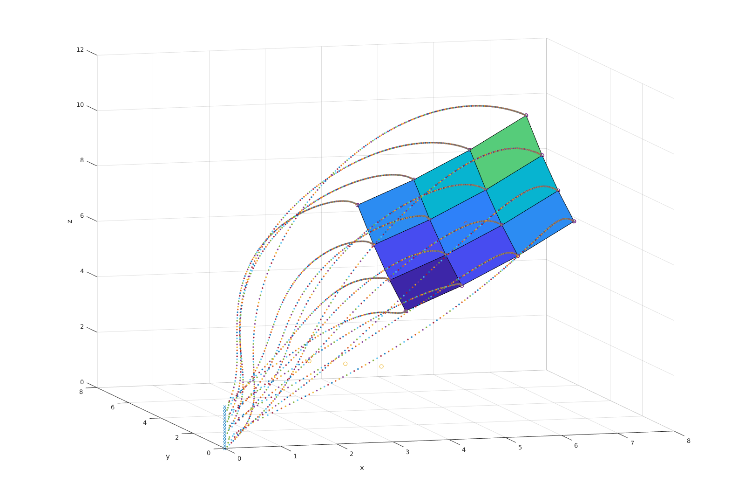
POTENTIAL FIELDS BASED TRANSLATIONAL CONTROL
Potential Fields are based on the linear spring law formulation that allows to define a target configuration for which the elements will be in equilibrium. The bodies will act as if immersed in a virtual force field, reordering according to the spring graph.
2D Deployment Problem
3D Deployment Problem

Slide 12
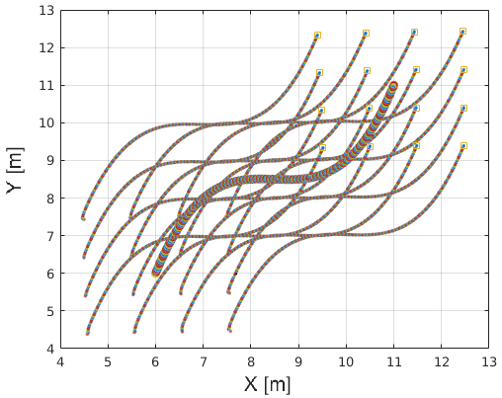
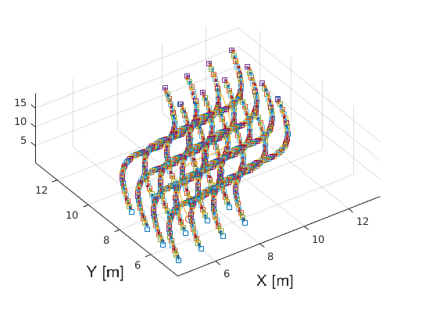
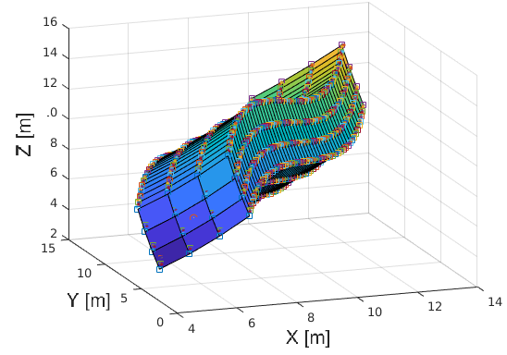
POTENTIAL FIELDS BASED TRANSLATIONAL CONTROL
MACRODYNAMICS: Rigid Movement of the Swarm
Once the structure is deployed, a trajectory can be generated for a few landmark robots, so that all the other ordinary robots will move accordingly, based on the spatial informations contained in the spring graph.
This is useful when the deployed swarm needs to be rigidly retargeted and oriented.

Slide 13

INDIVIDUAL LAGRANGIAN-BASED CONTROL
Potential fields based Translational control
Quaternion based attitude control
Simple implementation based on the linear spring law formulation.
Decentralized algorithm, having collision avoidance characteristics.
Defined with respect to the ORF.
Quaternions are defined with respect to the inertial reference frame.
Asymptotically stable attitude control formulation.

Slide 14
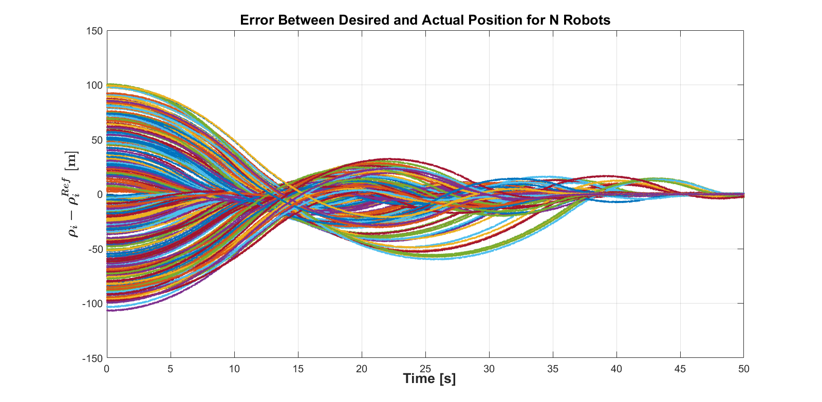
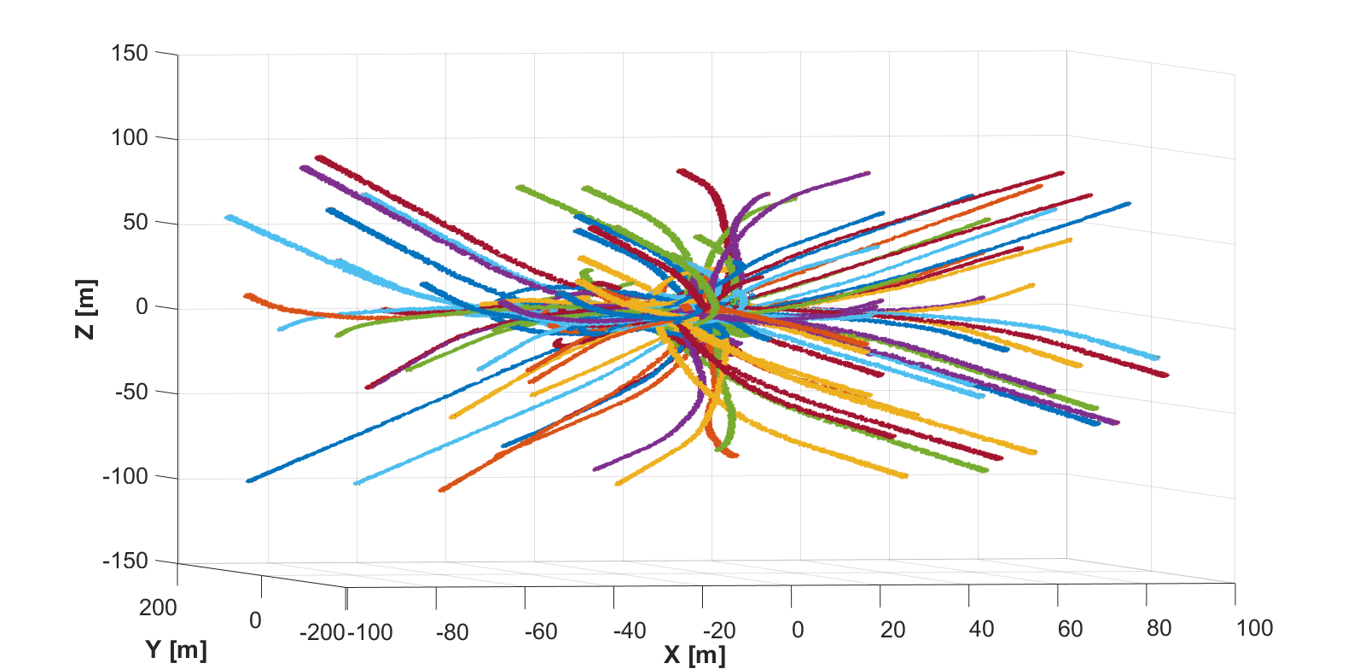
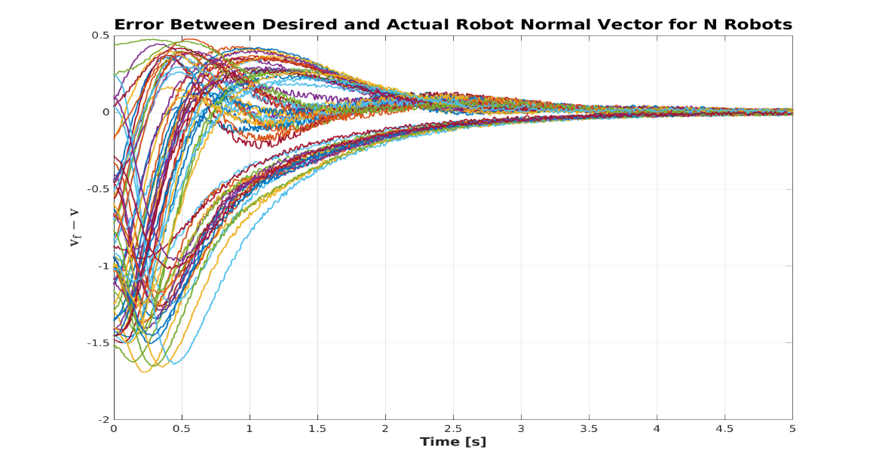
NUMERICAL SIMULATIONS OF THE RECONFIGURATION PROBLEM
By applying the defined controllers on a swarm of N=100 agents, convergence is reached both in position and orientation to the desired target values.
Redistribution of N=100 agents

Slide 15
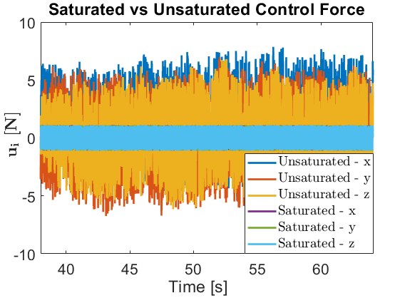
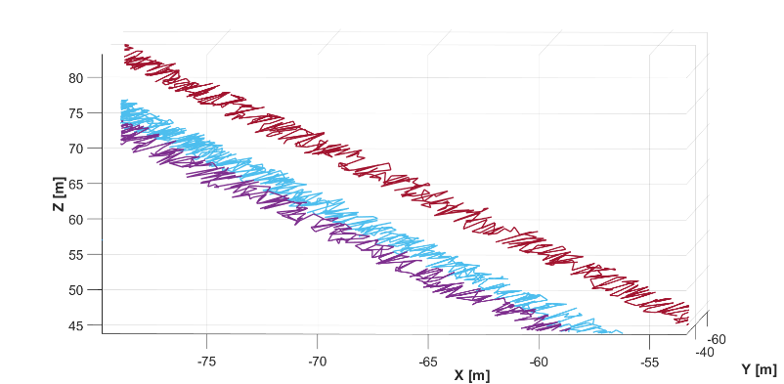
DOWNSIDES OF THE POTENTIAL FIELDS CONTROL
Enlarging the swarm dimensions, the potential fields forces exerted among the particles increase, saturating the actuation capabilites.
The precision loss due to the addition of random noises and unmodeled disturbances acting on the system degrades the quality of the control design.
The limited actuation strenghts and autonomies of the small satellites must be considered, thus introducing fuel efficient trajectories.
The necessity for an alternative arises.

Slide 16
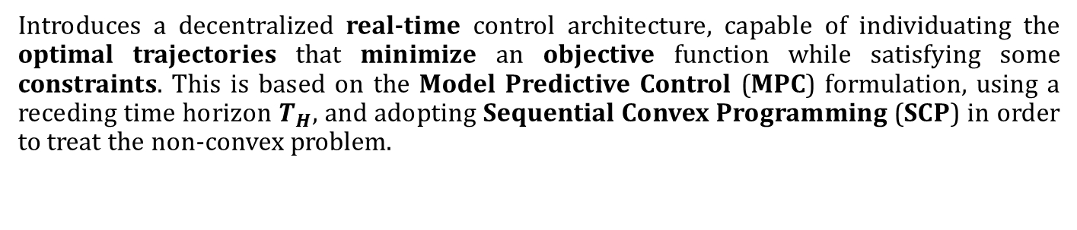
MODEL PREDICTIVE CONTROL APPROACH
Introduces a decentralized real-time control architecture, capable of individuating the optimal trajectories that minimize an objective function while satisfying some constraints. This is based on the Model Predictive Control (MPC) formulation, using a receding time horizon $T_{H}$, and adopting Sequential Convex Programming (SCP) in order to treat the non-convex problem.
MPC-SCP Convex Optimization
Discretized and Decentralized (Approximated) Convex Problem
Nonlinear Optimal Control Problem

Slide 17
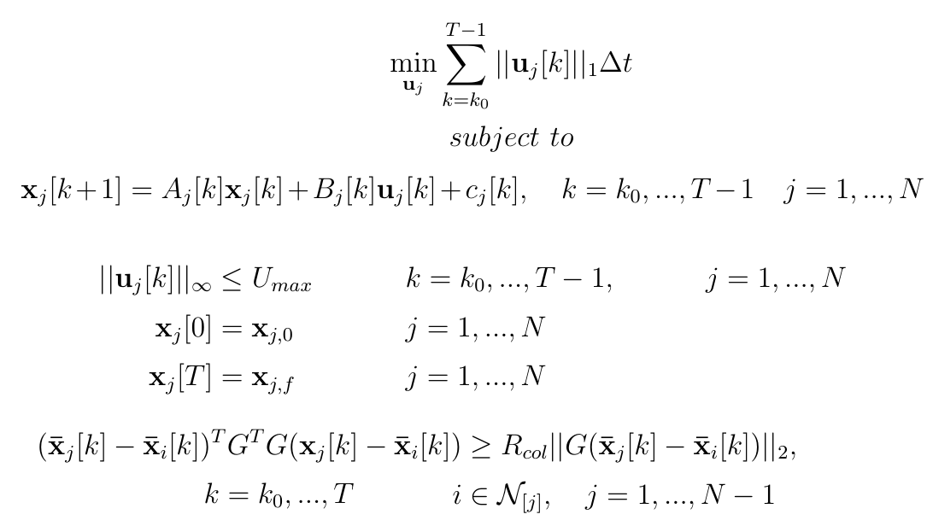
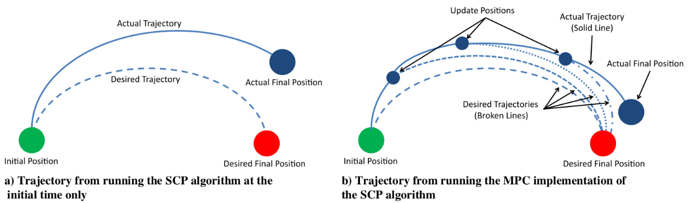
MPC-SCP CONVEXIFIED AND DISCRETIZED PROBLEM
Convexified and Discretized Optimization Problem
SCP algorithm uses the new trajectories identified in the optimization problem as nominal ones in the following iteration step, until convergence.
The MPC approach exploits the new measurements of the real system in order to provide a robust control strategy against unmodeled disturbances and errors.
which requires a linearization of the system defined before.

Slide 18
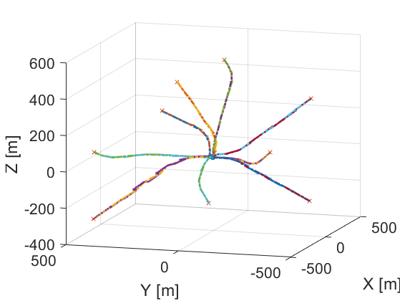
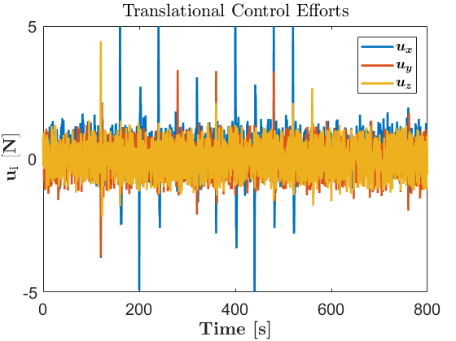
MPC-SCP APPLICATION ON THE NONLINEAR SYSTEM – ITERATION STEPS
Initial offline SCP trajectory generation, considering zero nominal trajectories and no collision avoidance constraints.
Real-time MPC-SCP iteration begins, considering the new trajectories as the nominal ones for the collision avoidance with respect to the neighboring particles.
Repeat to convergence.
As soon as the MPC-SCP iteration converges, upload the trajectories to the nonlinear system.
(Simulating the nonlinear system up to the new time).

Slide 19
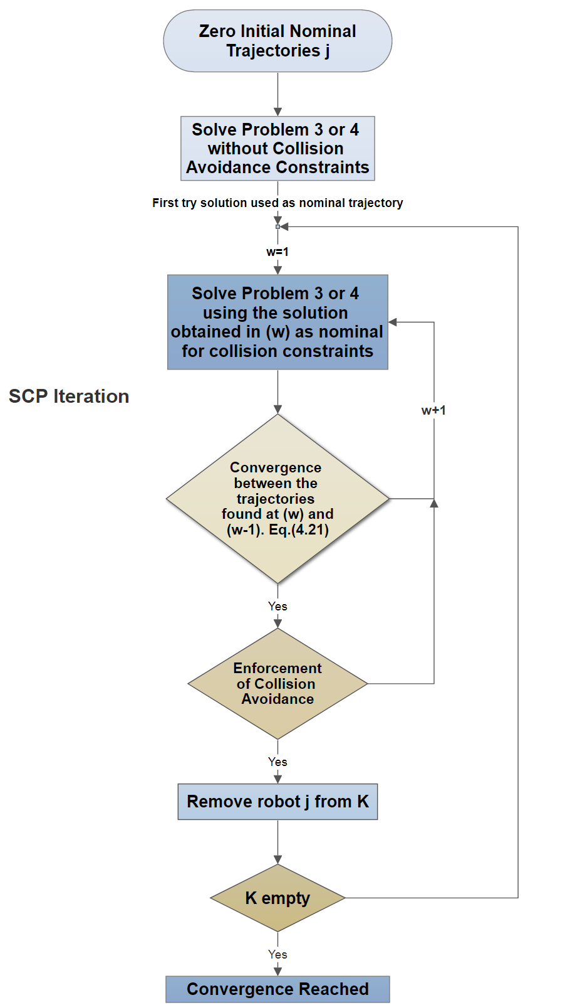
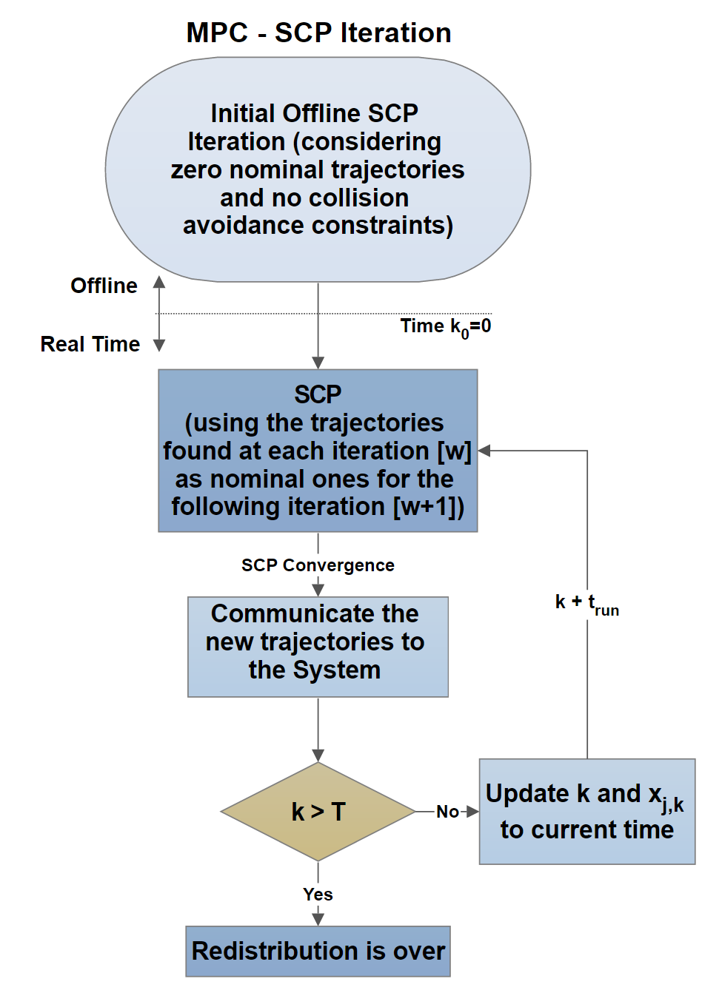
MPC-SCP APPLICATION ON THE NONLINEAR SYSTEM – ITERATION STEPS

Slide 20
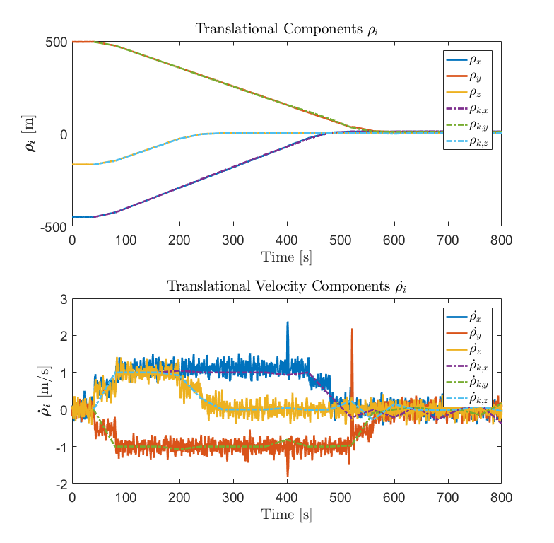
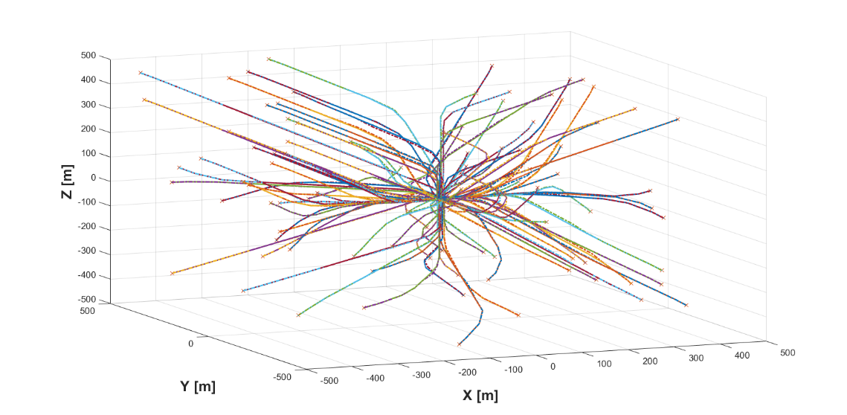
MPC APPLICATION ON THE NONLINEAR SYSTEM
Considering N=100 agents, and relevant noises affecting the system, we expect an increase in computational times mainly due to the increasing number of collision avoidance constraints.
Swarm reconfiguration in the workspace
i-th agent position and velocity convergence

Slide 21
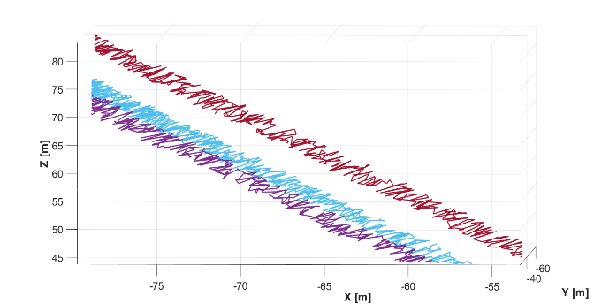
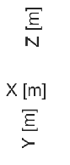
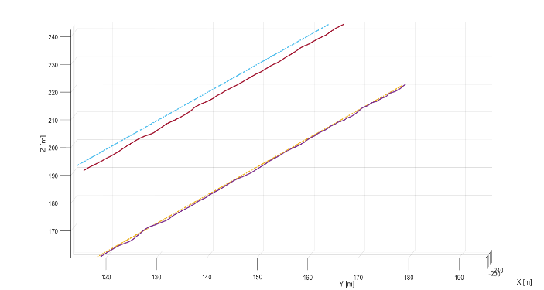
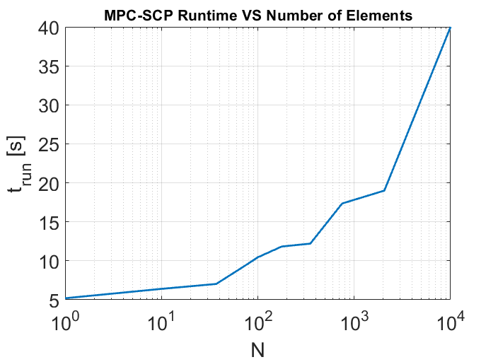
IMPROVEMENTS DUE TO THE MPC-SCP INTRODUCTION
Minimization of the control efforts required to reorder the elements
Important for the limited autonomies of the nano and femtosats.
Higher precision in the reference tracking problem, caused by the reduced fuel consumption.
Improved robustness against external unmodeled disturbances and parameter uncertainties or noises.
Scalability is still poor with respect to the increase in the cloud dimensions.
Spatial trajectories (Potential Fields Control).
Spatial trajectories (MPC-SCP Control).
Runtime vs Dimension

Slide 22
Firma convenzione Politecnico di Milano e Veneranda Fabbrica del Duomo di Milano
EULERIAN APPROACH FOR THE CONTROL OF A DISTRIBUTED SYSTEM
Aula Magna – Rettorato
Mercoledì 27 maggio 2015

Slide 23
ORBITING RAINBOWS
Orbiting Rainbows is an example of distributed non-contacting granular media forming a space-based observatory.
The dimensions of the charged grains of dust are in the order of microns.
If N becomes consistent, a continuum-based Eulerian framework is often preferred, where the collective properties of the swarm (e.g., its probability distribution) are controlled.

Slide 24
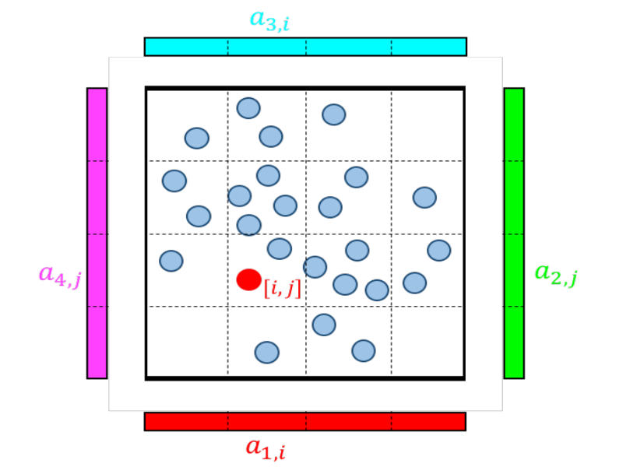
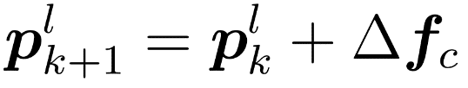
OPTIMAL TRANSPORT
The passive nature of the particles entails the introduction of external electric-field based actuators, making the system under-actuated.
Modeling the cloud as a probability distribution, the control challenge is formulated as an optimal transport problem.
Optimal Transport (OT) is based on convex optimization, used to plan the optimal transference from an initial to a desired probability distribution, with respect to the given cost function.

Slide 25
OPTIMAL TRANSPORT
The passive nature of the particles entails the introduction of external electric-field based actuators, making the system under-actuated.
Modeling the cloud as a probability distribution, the control challenge is formulated as an optimal transport problem.
Optimal Transport (OT) is based on convex optimization, used to plan the optimal transference from an initial to a desired probability distribution, with respect to the given cost function.
The particles propagation is described through an Euler step, whose amplitude depends from the strenght and distance of each actuator.

Slide 26
TIME EXTENSION OF THE OT BASED PROBLEM
OT minimizes the L2 distance between the instantaneous and the desired probability distribution.
Fuel efficiency is not considered in the standard OT formulation.
It is possible to extend the minimization algorithm throughout the whole timeline of the redistribution.
This results in minimum control actions, and improved robustness.

Slide 27
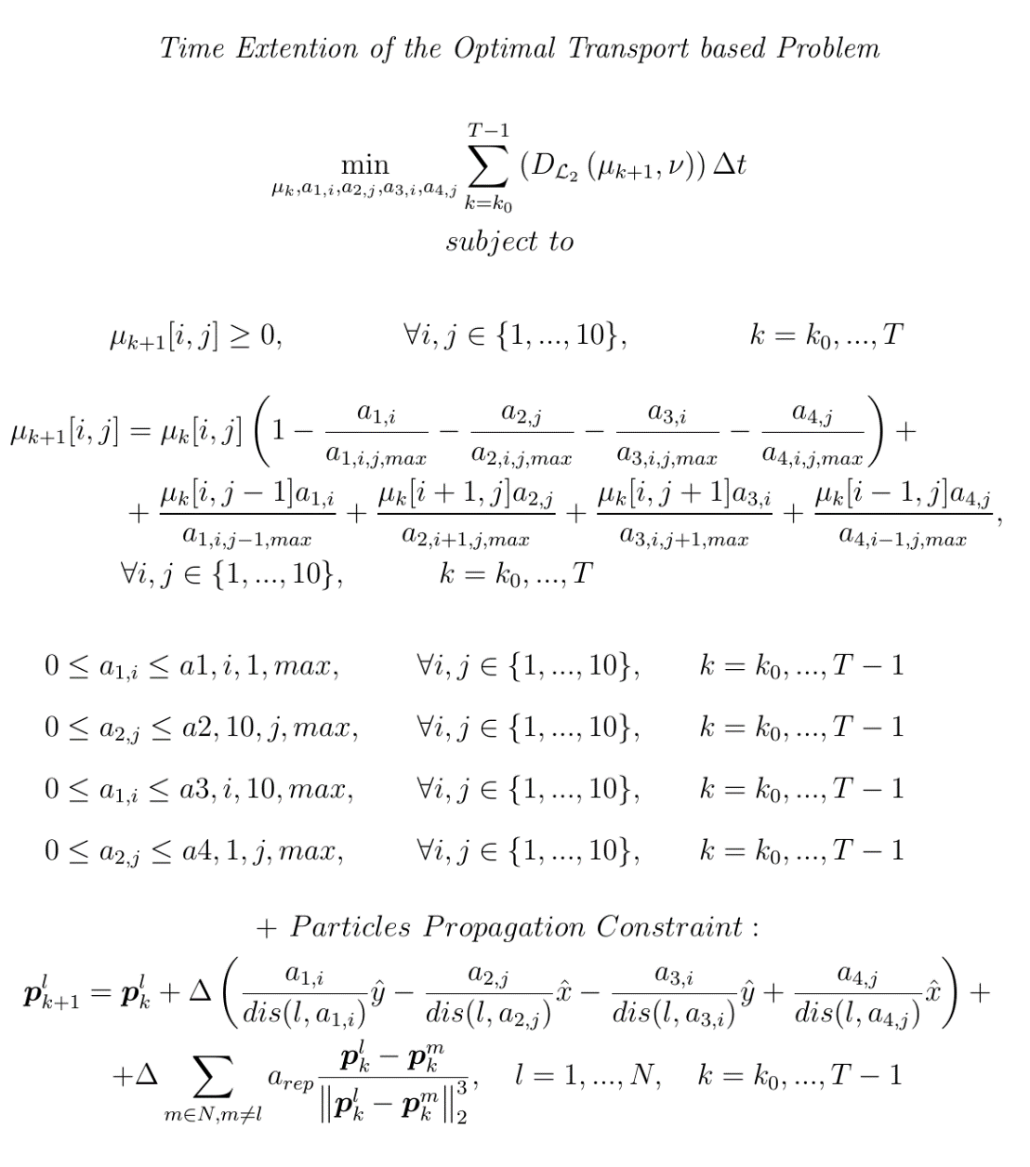
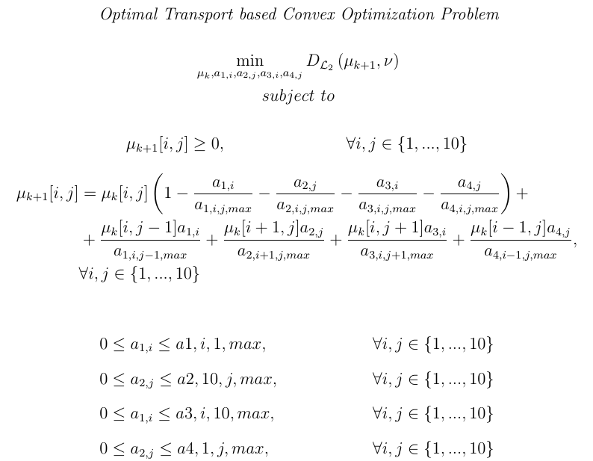

TIME EXTENSION OF THE OT BASED PROBLEM

Slide 28
TIME EXTENSION OF THE OT BASED PROBLEM

Slide 29
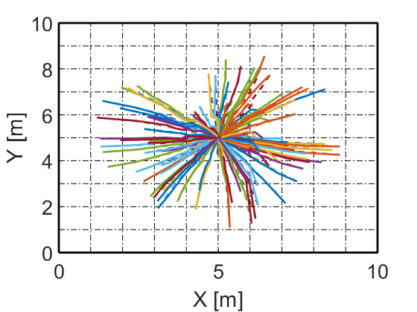
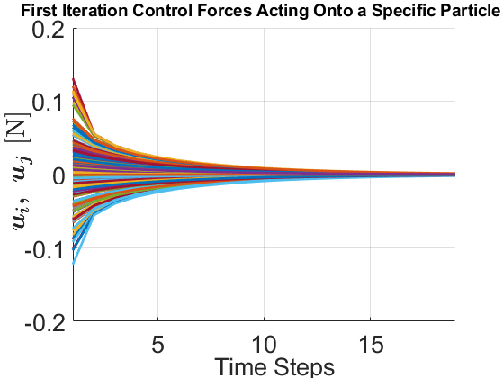
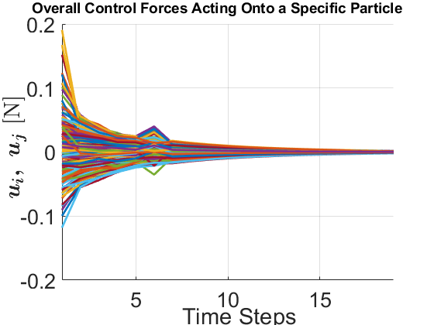
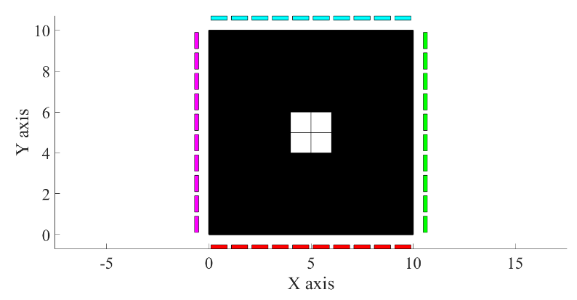
TIME EXTENSION OF THE OT BASED PROBLEM – NUMERICAL SIMULATIONS
Reconfiguration of N=100 grain elements.
First iteration control actions felt by each particle [N=100].
Desired probability distribution.
Overall control actions felt by each particle [N=100].

Slide 30
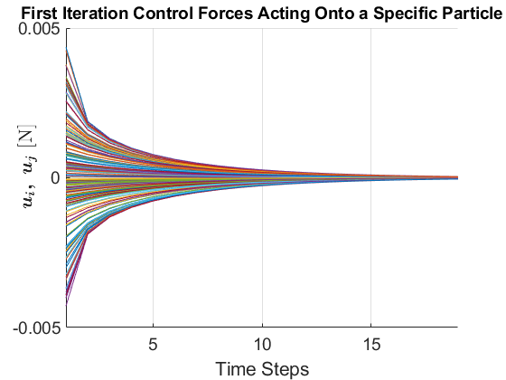
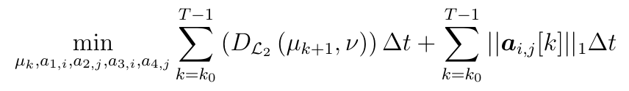
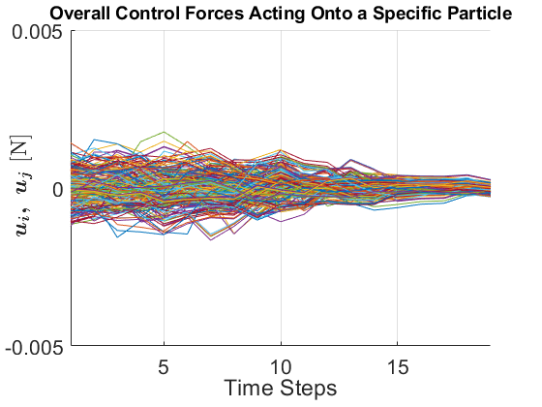
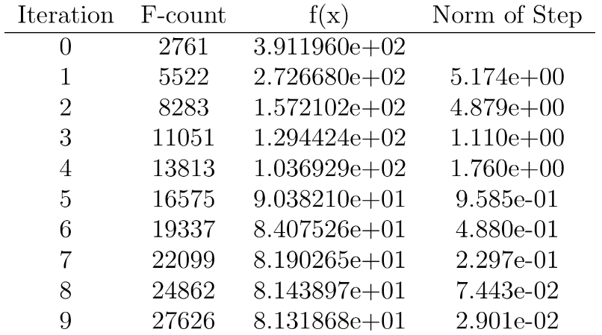
OBJECTIVE FUNCTION MODIFICATION
In order to reduce the control effort, the objective function is modified:
First iteration control actions felt by each particle [N=100].
It includes the fuel efficiency problem, by minimizing the control actions used throughout the redistribution timeline.
For N=100 particles it is possible to save up to 5% of the consumed energy.
Overall control actions felt by each particle [N=100].

Slide 31
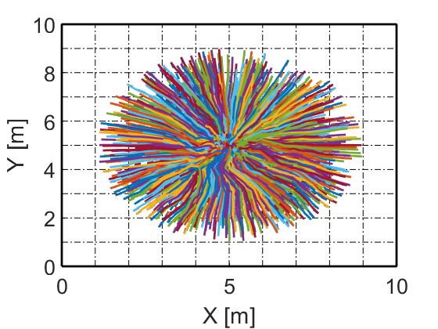
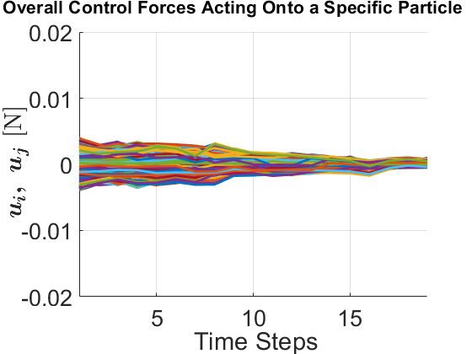
INCREASED CLOUD DIMENSIONS
Increasing the number of granules composing the cloud, the control scalability is studied:
Reconfiguration of N=1000 grain elements.
Increased interactions between particles are well handled by the OT implementation.
Good scalability of the process.
The increase in computational times is related to the amount of optimization constraints.
Increasing the cloud dimensions, the amount of saved control energy augments.
Overall control actions felt by each particle [N=1000].

Slide 32
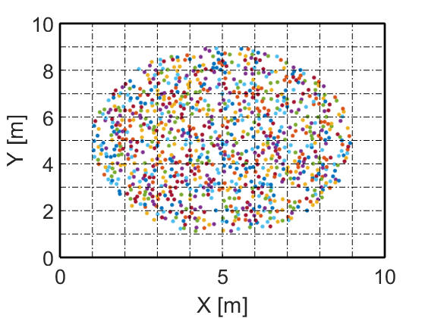
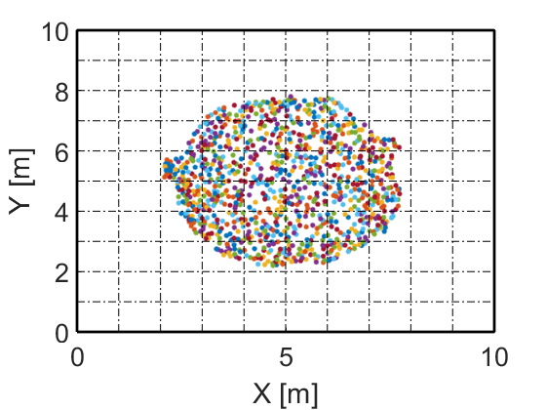


1000 GRAIN CLOUD SIMULATION
k = 0
k = 10
k = 20
k = 30

Slide 33
OT BASED EULERIAN APPROACH - FEATURES
Scalability
Adopting an Eulerian based approach like the OT, used to control the probability distribution, allows to achieve greater scalability with respect to the increase in the cloud dimensions.
Fuel efficiency
It is possible to include the problem of fuel consumption minimization by adopting a motion planning approach based on the optimized trajectories calculated offline.
Real time
A real-time control implementation based on the MPC approach already seen for the swarm of active robots, could provide higher robustness against external effects. However, the computational complexity noticeably augments.

Slide 34
CONCLUSIONS – LAGRANGIAN AND EULERIAN FRAMEWORKS COMPARISONS
LAGRANGIAN FRAMEWORK
EULERIAN FRAMEWORK
Deterministic Approach Higher precision and possibility of formation flying applications.
Classic Implementation Abundant literature available.
Fuel Efficiency The optimization allows to minimize the actuation energy and to improve the robustness to external disturbances.
Increasing Dimensions When the number of elements increases, the Eulerian framework can grant better scalability.
Flexibility Reduced sensitivity to the issue of loss of bodies and changes in the amount of constituents.
Real Time Difficult real-time implementation of the MPC based logic for very large clouds.

Slide 35
CONCLUSIONS – HYBRID DISTRIBUTED CONTROL
Hybrid VLSR System
Lagrangian Based Control Framework
Used for controlling the specific element during the final stage of precision manoeuvering and formation flying.
Swarm of active robots
Addition of external actuators
Euler Based Control Framework
Avoid generating individual control actions for each robot.
Limited amounts of energy and autonomy available.
The greater efforts of the redistribution task would be absorbed by the non-contacting actuators.
Used in the initial deployment phase when the requirement is to regroup and coarsely confine the cloud in a specific region.

Slide 36
Firma convenzione Politecnico di Milano e Veneranda Fabbrica del Duomo di Milano
THANKS FOR THE ATTENTION
Aula Magna – Rettorato
Mercoledì 27 maggio 2015

